Slide 1
MET CS 555 – Foundations of Machine Learning Lecture 2: Normal Distribution, Central Limit Theorem
Hongsheng Wu
Boston University

Slide 2
Study Guide
Normal Distribution
Standard Normal Distribution
Outliers
Sampling
Central Limit Theorem

Slide 3
Normal Distribution

Slide 4
Normal Distribution – known as “Gaussian” Distribution
Many statistical inference procedures are based on the normal distribution
The density curve (a mathematical model that represents the pattern of data) of normal distribution has a very familiar, bell curve shape with a single peak. It is perfectly symmetrical

Slide 5
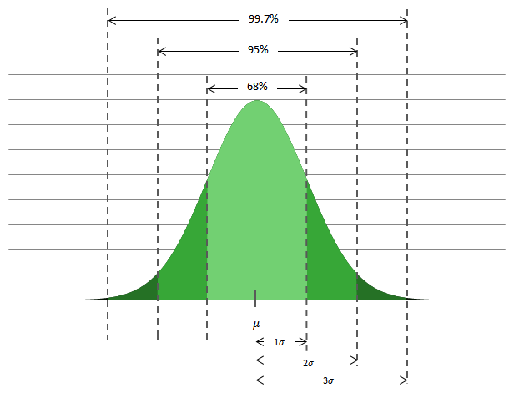
Normal Distribution – 68-95-99.7 Rule
For a normal distribution with mean: μ, and standard deviation: σ
68% of the observations fall within one standard deviation of the mean
95% of the observations fall within two standard deviations of the mean
99.7% of the observations fall within three standard deviations of the mean
Notes:
Mu little sigma

Slide 6
Normal Distribution Example
Let’s assume that the distribution of birth weights is normally distributed with a mean of 3500 grams with a standard deviation of 500 grams.
What proportion of infants weigh between 3000 and 4000 grams at birth?
What proportion weighs between 2500 and 4500 grams?
What percentage weighs more than 4000 grams?
Notes:
68%
95%
16%

Slide 7
Exercise
The distribution of SAT scores for the verbal section for high school seniors is approximately a normal distribution with a mean of 504 and a standard deviation of 111
What proportion of seniors score between 393 and 615?

Slide 8

Normal Distribution
The normal distribution with mean μ and variance σ² is often referred to as N(μ, σ²)
When a random variable X is distributed normally with mean μ and variance σ², may write
The above notation means also that X is sampled from N(μ, σ²)
Notes:
μ mu
σ sigma

Slide 9
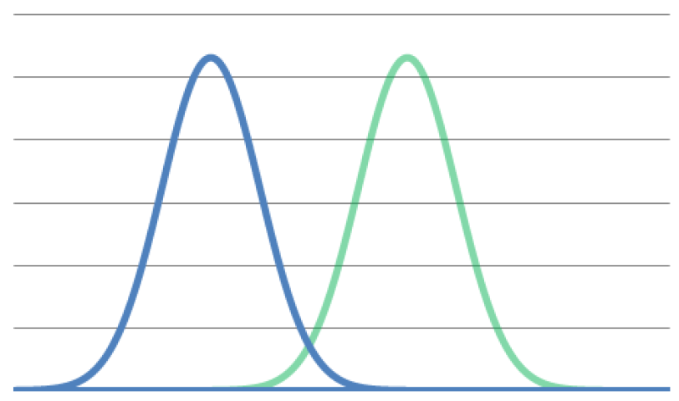
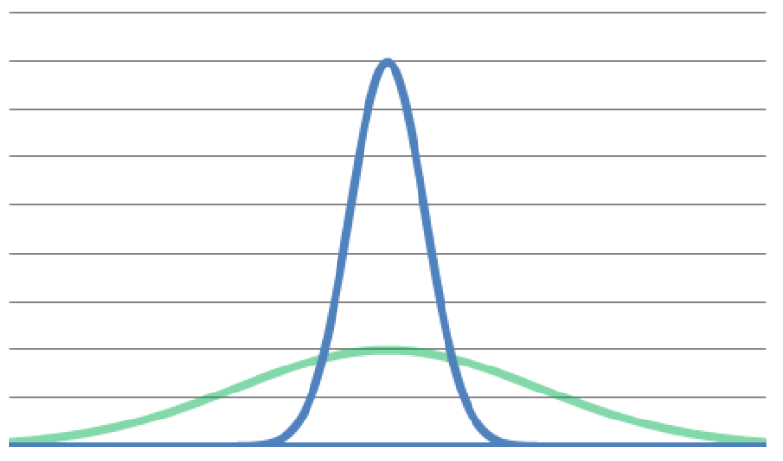
Normal Distribution – μ, σ
For a normal distribution with mean: μ, and standard deviation: σ, it is often denoted N(μ, σ). The mean is the center of the distribution. It is the point that splits the area under the bell-shaped curve in half
μ₁
μ₂
Different Variance
Different Means

Slide 10
Standard Normal Distribution

Slide 11
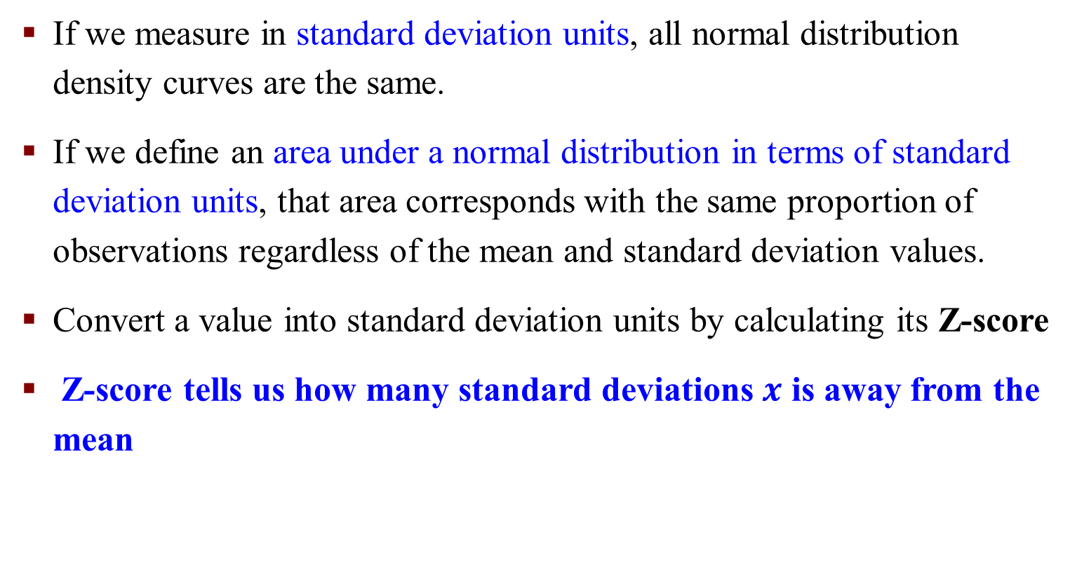
Standardized Normal Distribution
If we measure in standard deviation units, all normal distribution density curves are the same.
If we define an area under a normal distribution in terms of standard deviation units, that area corresponds with the same proportion of observations regardless of the mean and standard deviation values.
Convert a value into standard deviation units by calculating its Z-score
Z-score tells us how many standard deviations $x$ is away from the mean

Slide 12
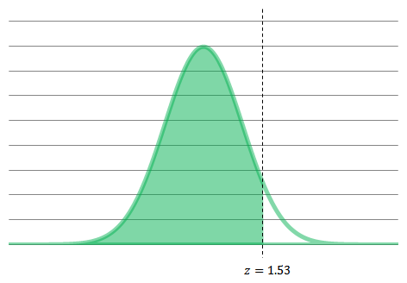

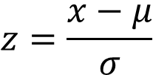
Standardized Normal Distribution
Convert a value into standard deviation units by calculating its Z-score
Z-score tells us how many standard deviations x is away from the mean
$$z=\frac{x−μ}{σ}$$
$$N\sim (0, 1)$$
The area under the standard Normal curve to the left of z is 0.9370.

Slide 13
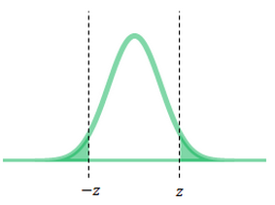
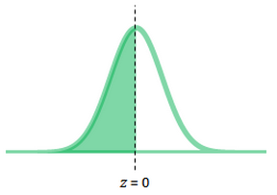
Properties of Standardized Normal Distribution
The total area under the standard normal curve is 1.00.
The curve is perfectly symmetrical. If z is greater than 0, then the probability that a given observation is less than −z is equal to the probability that a given observation is greater than z.
The standard normal curve is centered on 0.
The probability that z ≥ a is equal to the probability that z > a. There is no area under the curve for a single point. Similarly, the probability that z ≤ a is equal to the probability that z < a.

Slide 14
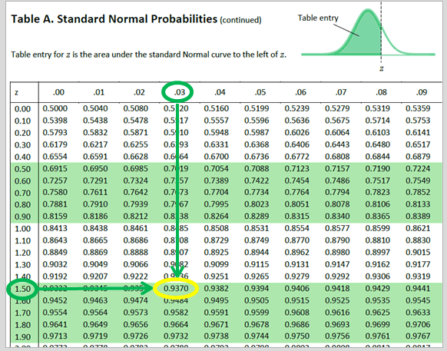

Slide 15
Exercise
Using the tables, find the area under the standard normal curve to the left of z =1.53
Find the proportion of observations greater than z = −0.58

Slide 16
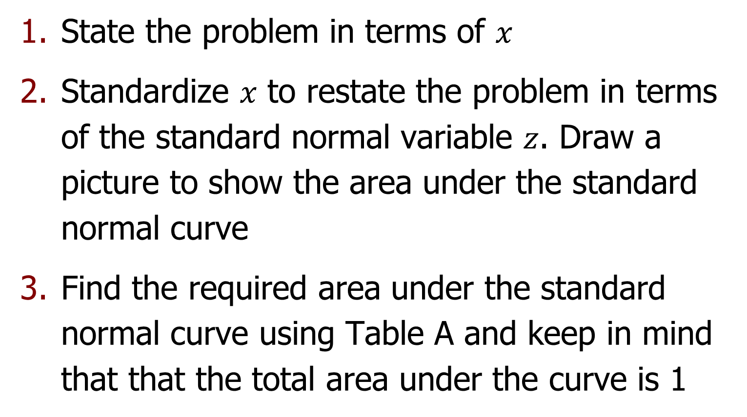
Steps to Solve the Question
State the problem in terms of $x$
Standardize $x$ to restate the problem in terms of the standard normal variable $z$. Draw a picture to show the area under the standard normal curve
Find the required area under the standard normal curve using Table A and keep in mind that that the total area under the curve is 1

Slide 17
Exercise
Using the tables, find the area under the standard normal curve between z = -1.25 and z = 0.77
The area to the left of z = −1.25 is 0.1056
The area to the left of z = 0.77 is 0.7794
The area between z = −1.25 and z = 0.77 is equal to 0:7794−0.1056 = 0.6738

Slide 18
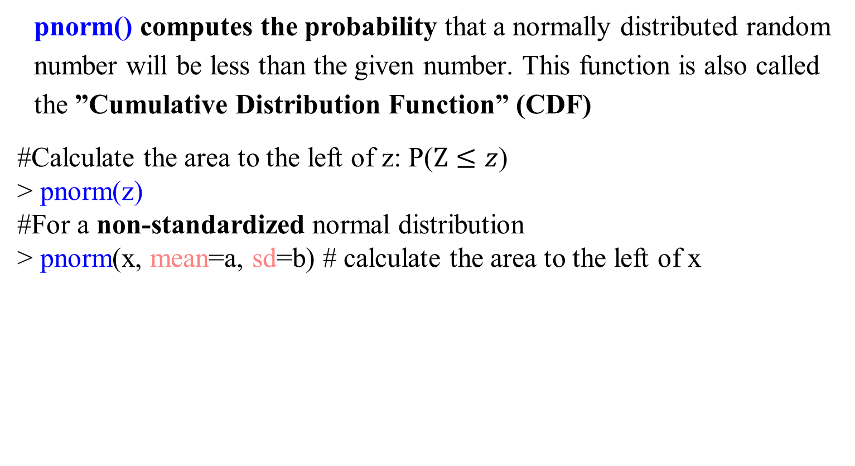
R Functions: Normal Distribution
pnorm() computes the probability that a normally distributed random number will be less than the given number. This function is also called the ”Cumulative Distribution Function” (CDF)
#Calculate the area to the left of z: P($Z≤z$)
> pnorm(z)
#For a non-standardized normal distribution
> pnorm(x, mean=a, sd=b) # calculate the area to the left of x

Slide 19
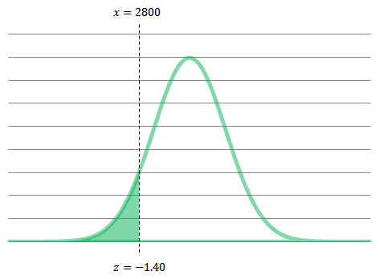

Exercise
Let’s assume that the birth weights of newborns are normally distributed with a mean of 3500g with a standard deviation of 500g
What proportion of infants weighs less than 2800g? Manual and R
The variable x, the birth weight, has the N(3500,500) distribution
The value in Table A for z=−1.40 is 0.0808. As such, 8.08% of infants weigh less than 2800g
R command

Slide 20
Exercise
Let’s assume that the birth weights of newborns are normally distributed with a mean of 3500g with a standard deviation of 500g.
What proportion of infants weigh between 3250g and 3750g?

Slide 21
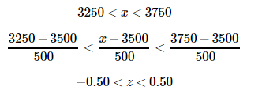
State the problem in terms of x. Let x be the birth weight of infants. The variable x has the N(3500,500) distribution. We are interested in the proportion of infants with 3250<x<3750 grams
Standardize x to restate the problem in terms of the standard normal variable z
Find the required area under the standard normal curve using the Table. The area between z=−0.50 and z=0.50 is 0.6915–0.3085=0.3830
R command

Slide 22
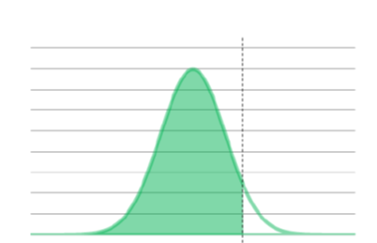


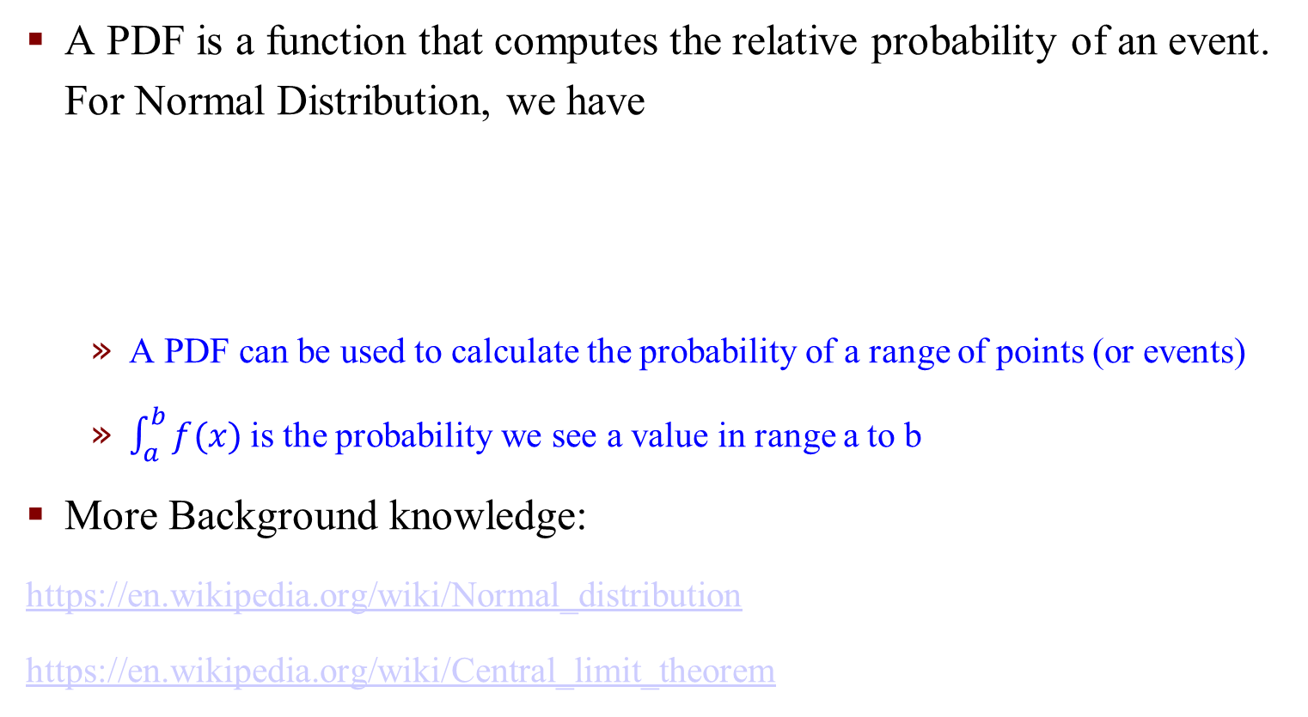
Probability Density Function
A PDF is a function that computes the relative probability of an event. For Normal Distribution, we have
A PDF can be used to calculate the probability of a range of points (or events)
$\int_{a}^{b}{f(x)}$is the probability we see a value in range a to b
More Background knowledge:
https://en.wikipedia.org/wiki/Normal_distribution
https://en.wikipedia.org/wiki/Central_limit_theorem

Slide 23
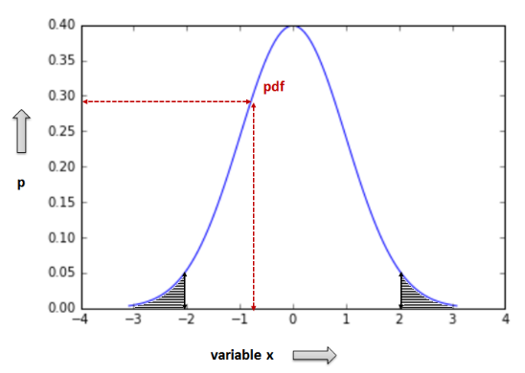
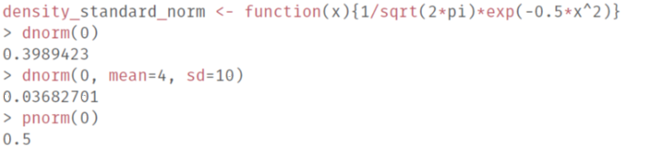
R Functions on Normal Distribution
dnorm() - Given a set of values it returns the height of the probability distribution at each point. If you only give the points, it assumes you want to use a mean of 0 and standard deviation of 1.
Normal Distribution Probability density function (PDF)
For standard normal distribution we have μ= 0, σ = 1
Notes:
μ mu
σ sigma
dnorm() is the density function for the normal distribution

Slide 24
R Functions on Normal Distribution - qnorm
In statistics, quantiles are cut points dividing the range of a probability distribution into contiguous intervals with equal probabilities.
Given a probability p and a distribution, we want to calculate the corresponding quantile for z: the value x such that P(X< x) = z
For example, suppose you want to find the 85th percentile of a normal distribution whose mean is 70 and whose standard deviation is 3
qnorm(0.85, mean=70, sd=3)
[1] 73.1093
Notes:
pnorm<->qnorm

Slide 25
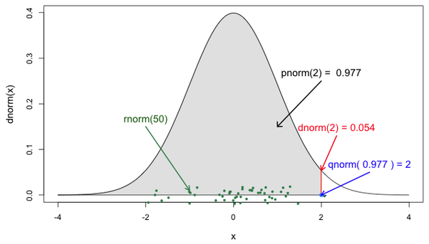
R Functions on Normal Distribution
Density, distribution function, quantile function and random generation for the normal distribution with mean equal to mean and standard deviation equal to sd.
Usage:
rnorm: Generate n random samples in the space X
Notes:
Rnorm: Generate random samples in the space X

Slide 26
Outliers

Slide 27
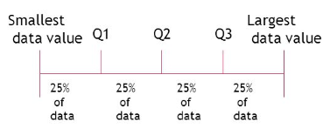

Outliers
Outliers are data points that do not fit with the general pattern of the data. They can be detected using graphical summaries
Quartiles divide a rank-ordered data set into four equal parts. The values that divide each part are called the first, second, and third quartiles; They are denoted by Q1, Q2, and Q3, respectively.
Q1 is the ”middle” value in the first half of the rank-ordered data set.
Q2 is the median value in the set.
Q3 is the ”middle” value in the second half of the rank-ordered data set.
IQR (Inter-Quartile Range) = Q3 - Q1 (good to evaluate skewed data)
It is a measure of variability. Outliers are defined as any points that are
$≤Q1−1.5×IQR$ or $≥Q3+1.5×IQR$

Slide 28
Outliers – An Example
The earnings (in thousands of dollars) for 9 people are:
⟨35; 40; 145; 33; 30; 42; 32; 32; 2; 5⟩
boxplot() function in R can detect outliers and visualize it

Slide 29
Sampling

Slide 30
Sampling
The population: an entire group of individuals or things that we want information about or to answer questions about
A Sample: a set of data collected and/or selected from a statistical population by a defined procedure
The elements of a sample are known as sample points, sampling units, or observations
Often, we gather information about the only part of the population (sample) and use this information to make educated guesses about the qualities of the larger group (population)

Slide 31
Selection Bias
Biases introduced by sampling are often termed selection biases
To avoid them, samples by chance
Ensuring that each individual or element from the population has an equal chance of being selected is key to protecting against selection bias
Our data collection method is critically important to our ability to analyze data correctly and to make inferences and conclusions
We should be mindful of sampling methods and the potential for bias as we critically analyze our results

Slide 32
Inference about a Population
A parameter is a number that describes a population
A statistic is a number that is computed from the sample data
Typical notation for population parameters and their corresponding sample statistic:

Slide 33
Exercise
Voter registration for Massachusetts showed that 76% of party-affiliated voters were registered as Democrats in October of 2012. A survey of 200 randomly selected voters exiting the polls in the last election in late 2014 showed that 74% of voters were registered as democrats. Is 76% a population parameter or a sample statistic? Is 74% a population parameter or a sample statistic?
The 76% number describes the population of registered voters in Massachusetts with a party affiliation. As such, this is a parameter. The 74% is a sample statistic since it was calculated from a sample of voters exiting the polls.

Slide 34
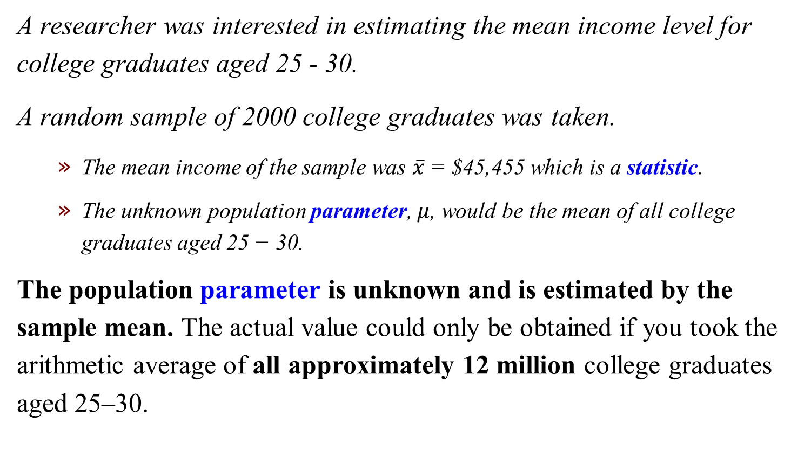
Example – A Parameter Vs. A Statistic
A researcher was interested in estimating the mean income level for college graduates aged 25 - 30.
A random sample of 2000 college graduates was taken.
The mean income of the sample was $\overline{x}$ = $45,455 which is a statistic.
The unknown population parameter, $μ$, would be the mean of all college graduates aged 25 − 30.
The population parameter is unknown and is estimated by the sample mean. The actual value could only be obtained if you took the arithmetic average of all approximately 12 million college graduates aged 25–30.

Slide 35
Central Limit Theorem

Slide 36
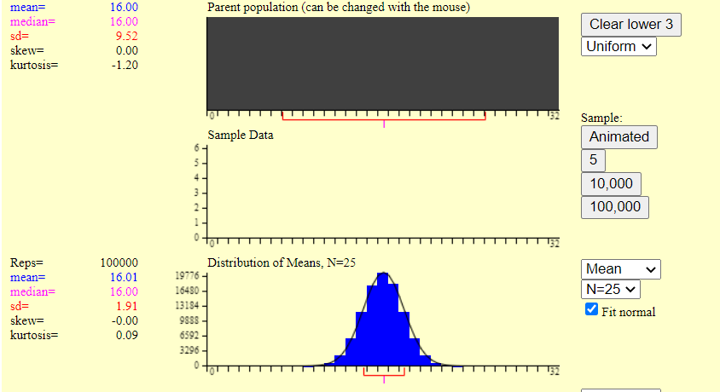
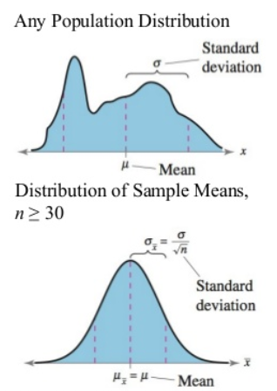
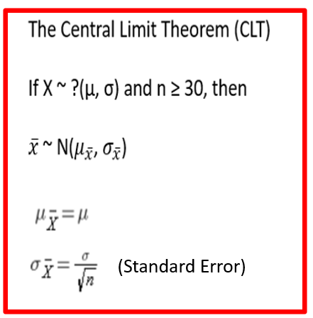
Let’s start with: https://onlinestatbook.com/stat_sim/sampling_dist/index.html
If ? Is normal, n can be any positive integer.

Slide 37

How Large Should n be?
If the underlying population is approximately normal, then even small values of n will give a sampling distribution of sample means that are normally distributed
Generally, the rule of thumb is that n should be n $≥$ 30 for the distribution of the sample means to be reasonably normally distributed
For more skewed population distributions, n must be larger before the sampling distribution is sufficiently normally distributed

Slide 38
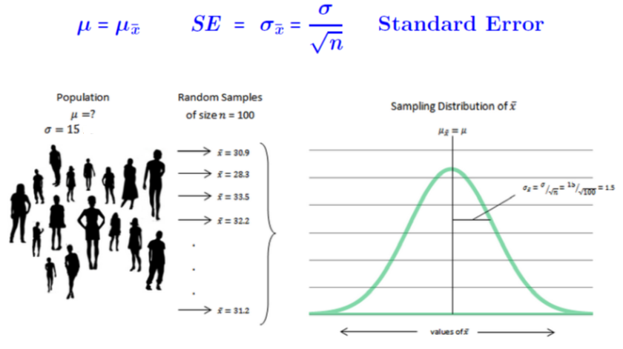
Exercise
Suppose we have selected a random sample of n = 36 from a population with a sample mean of 80 and population SD of 6
Find the probability that the sample mean will be between 79 and 81
(Manual and R)
Notes:
The sample has normal distribution, but sample sigma is population sigma/sqrt(n)

Slide 39
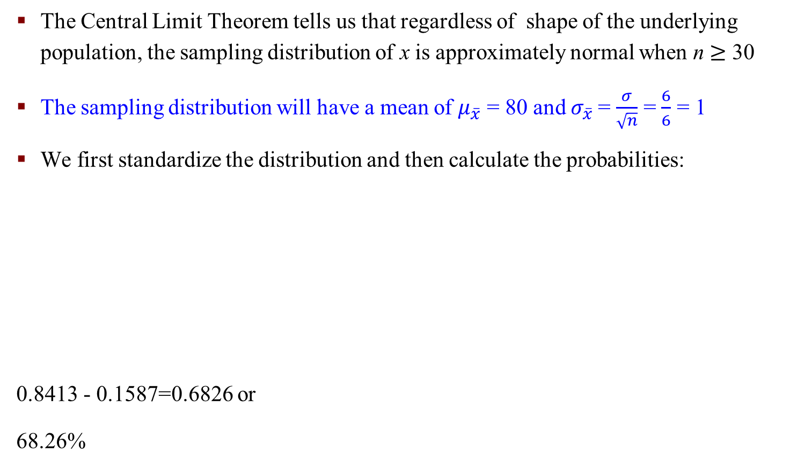
Answer
The Central Limit Theorem tells us that regardless of shape of the underlying population, the sampling distribution of x is approximately normal when n $≥$ 30
The sampling distribution will have a mean of $μ_{\overline{x}}$ = 80 and $σ_{\overline{x}}$= $\frac{σ}{\sqrt{n}}$ = $\frac{6}{6}$ = 1
We first standardize the distribution and then calculate the probabilities:
0.8413 - 0.1587=0.6826 or
68.26%

Slide 40

Answer – Using R
Or
Notes:
Lower.tail = F which is the > z not <z

Slide 41
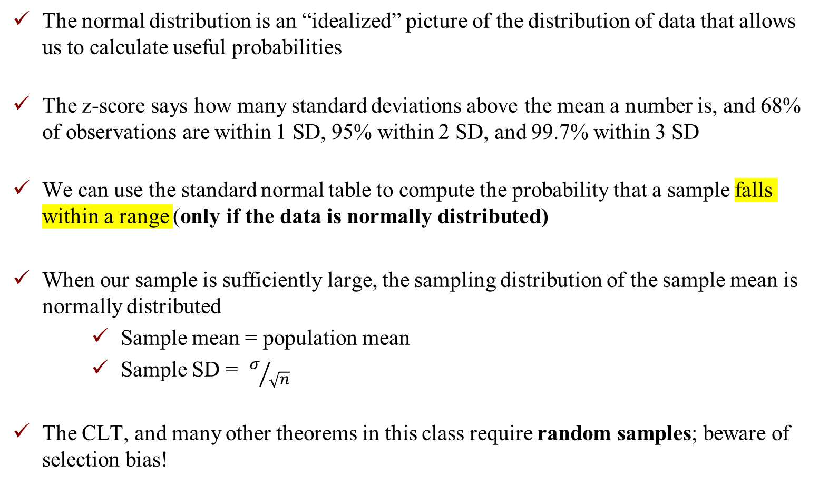
Summary
The normal distribution is an “idealized” picture of the distribution of data that allows us to calculate useful probabilities
The z-score says how many standard deviations above the mean a number is, and 68% of observations are within 1 SD, 95% within 2 SD, and 99.7% within 3 SD
We can use the standard normal table to compute the probability that a sample falls within a range (only if the data is normally distributed)
When our sample is sufficiently large, the sampling distribution of the sample mean is normally distributed
Sample mean = population mean
Sample SD = $σ/{\sqrt{n}}$
The CLT, and many other theorems in this class require random samples; beware of selection bias!

